Slide 1
Week 1
Introduction to Natural Language Processing

Slide 2
Topics covered in week 1
Introduction to Natural Language Processing
Pre-processing: Tokenization, Stop words, Normalization, Stemming and Lemmatization
Bag of Words and Tf-idf features
Language model
N-grams

Slide 3
Session Agenda
Basics of NLP
Pre-processing steps
Language Models
Case Study

Slide 4
Natural Language Processing

Slide 5
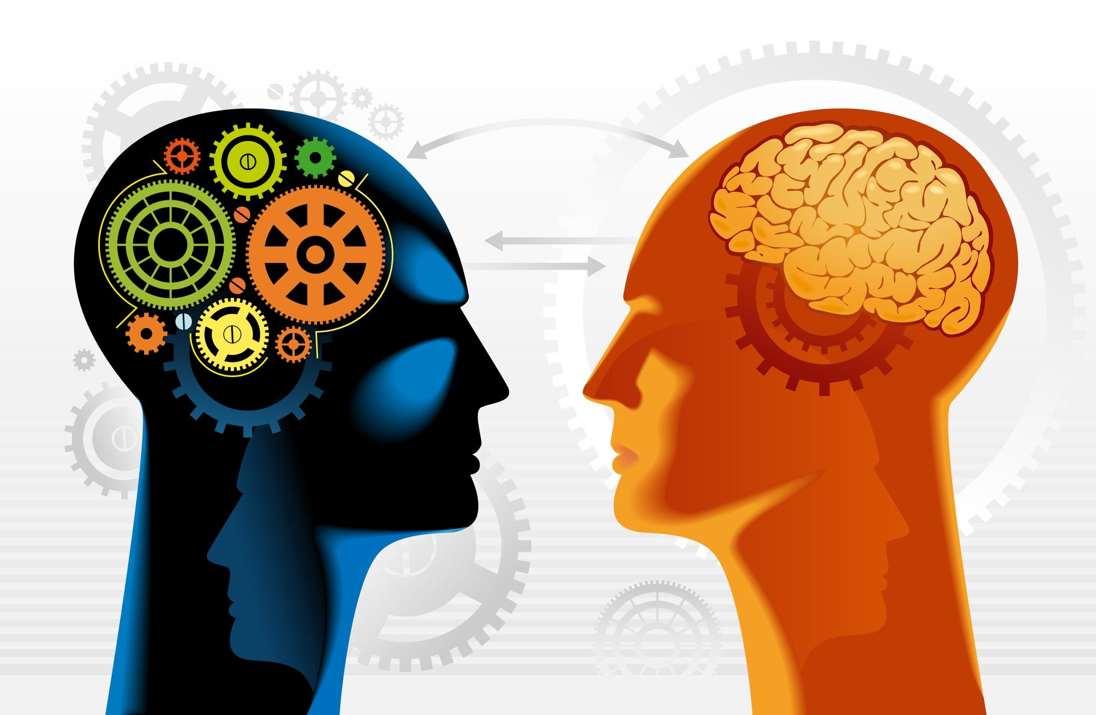
Natural Language Processing
Natural Language Processing is a subfield of artificial intelligence concerned with methods of communication between computers and natural languages such as english, hindi, etc.
Objective of Natural Language processing is to perform useful tasks involving human languages like
Sentiment Analysis
Machine Translation
Part of Speech Tags
Human-Machine communication(chatbots)

Slide 6




Why study NLP?
Language is involved in most of the activities that involve interaction between humans, e.g. reading, writing, speaking, listening.
Voice can be used as an interface for interactions between humans and machines e.g. cortana, google assistant, siri, amazon alexa.
There is massive amount of data available in text format which can used to derive insights from using NLP, e.g. blogs, research articles, consumer reviews, literature, discussion forums.

Slide 7
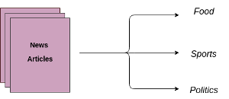

Different Tasks in NLP
Text Classification
Sentiment Analysis: Determining the general context of a review, whether it is positive or negative or neutral.
Consumer Complaints Classification: Categorizing complaints on consumer forums to respective departments.
Machine Translation
Improving human-human interaction by translating sentences from one language to another.

Slide 8
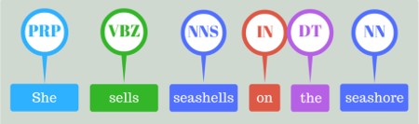
Different Tasks in NLP
Part of Speech Tagging
In corpus linguistics, part-of-speech tagging (POS tagging or PoS tagging or POST), also called grammatical tagging or word-category disambiguation, is the process of marking up a word in a text (corpus) as corresponding to a particular part of speech, based on both its definition and its context.
A simplified form of this is the identification of words as nouns, verbs, adjectives, adverbs, etc.
Tagset: https://www.ling.upenn.edu/courses/Fall_2003/ling001/penn_treebank_pos.html

Slide 9
Different Tasks in NLP
Word Segmentation
In some languages, there is no space between words, or a word may contain smaller syllables.n such languages, word segmentation is the first step of NLP systems.
Semantic Analysis
Semantic analysis of a corpus (a large and structured set of texts) is the task of building structures that approximate concepts from a large set of documents.
Application of Semantic Analysis:
Text Similarity
Context Recognition
Sentence Parsing
Topic Modelling

Slide 10
Why NLP is hard?
Languages are changing everyday, new words, new rules, etc.
The number of tokens is not fixed. A natural language can have hundreds of thousands of different words, new words are created on the fly.
Words can have different meanings depending on context, and they can acquire new meanings over time (apple(a fruit), Apple(the company)], they can even change their parts of speech(Google --> to google).
Every language has its own uniqueness. Like in the case of English we have words, sentences, paragraphs and so on to limit our language. But in Thai, there is no concept of sentences.

Slide 11
Pre-processing Steps

Slide 12
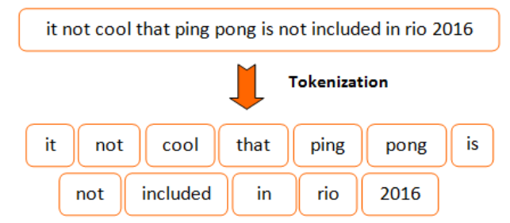
Tokenization
Tokenization is the task of taking a text or set of text and breaking it up into its individual tokens.
Tokens are usually individual words (at least in languages like English).
Tokenization can be achieved using different methods. Most common method is Whitespace tokenizer and Regexp Tokenizer. We will use them in our case study.

Slide 13
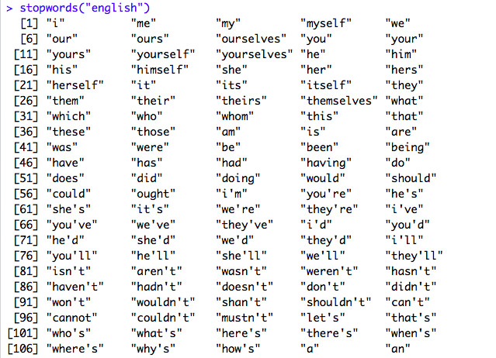
Stop Words Removal
Stopwords are common words that carry less important meaning than keywords.
When using some bag of words based methods, i.e, countVectorizer or tfidf that works on counts and frequency of the words, removing stopwords is great as it lowers the dimensional space.
Not always a good idea?
When working on problems where contextual information is important like machine translation, removing stop words is not recommended.

Slide 14
Stemming and Lemmatization
The idea of reducing different forms of a word to a core root.
Words that are derived from one another can be mapped to a central word or symbol, especially if they have the same core meaning.
In stemming, words are reduced to their word stems. A word stem is an equal to or smaller form of the word.
“cook,” “cooking,” and “cooked” all are reduced to same stem of “cook.”
Lemmatization involves resolving words to their dictionary form. A lemma of a word is its dictionary or canonical form!

Slide 15
Word Features

Slide 16
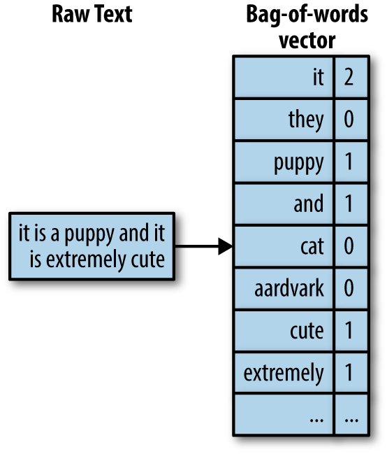
Bag of Words
In this model, a text (such as a sentence or a document) is represented as the bag of its words, disregarding grammar and even word order but keeping multiplicity.
We use the tokenized words for each observation and find out the frequency of each token.
We define the vocabulary of corpus as all the unique words in the corpus above and below some certain threshold of frequency.
Each sentence or document is defined by a vector of same dimension as vocabulary containing the frequency of each word of the vocabulary in the sentence.
The bag-of-words model is commonly used in methods of document classification where the (frequency of) occurrence of each word is used as a feature for training a classifier.

Slide 17
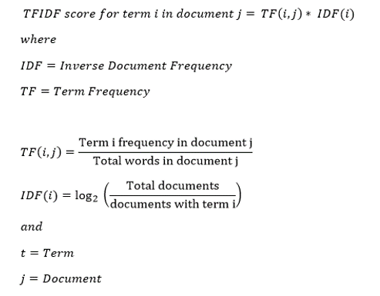
Tf-idf Vectors
Tf-idf (term frequency times inverse document frequency) is a scheme to weight individual tokens.
One of the advantage of tf-idf is reduce the impact of tokens that occur very frequently, hence offering little to none in terms of information.

Slide 18
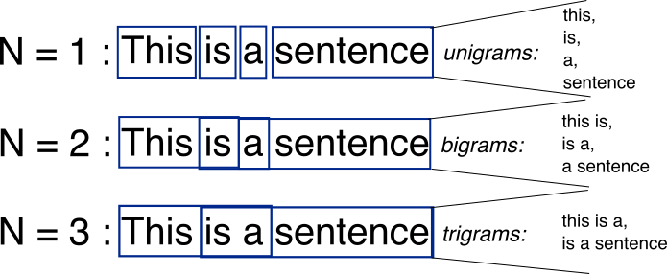
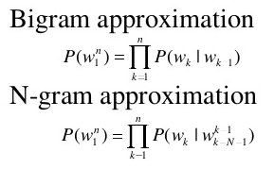
N-gram and Language Model
Language models are the type of models that assign probabilities to sequence of words.
N-grams is the most simplest language model. It’s a sequence of N-words.
Bi-gram is a special case of N-grams where we consider only the sequence of two words (Markovian assumption ).
In N-gram models we calculate the probability of Nth words give the sequence of N-1 words. We do this by calculating the relative frequency of the sequence occurring in the text corpus.

Slide 19


AIML @WORK
PGPAIML @ Great Learning
Enabling Learners to Apply the AI/ML Concepts at Work
Apply AIML at your workplace to gain some instant benefits:
Get noticed by your management with your outstanding analysis backed by data science.
Create an impact in your organization by taking up small projects/initiatives to solve critical issues using data science.
Network with members from the data science vertical of your organization and seek opportunities to contribute in small projects.
Share your success stories with us and the world to position yourself as a subject matter expert in data science.
AIML Operations | AIMLAW
@Great Learning Proprietary Content. All rights reserved. Unauthorized use or distribution prohibited

